Slide 1
Analysis of Balanced three phase system

Slide 2
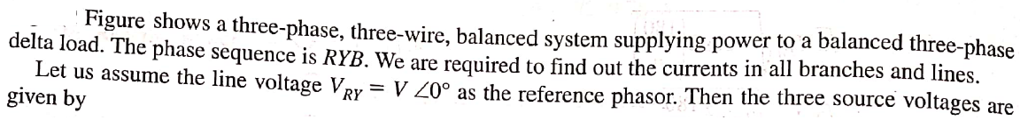
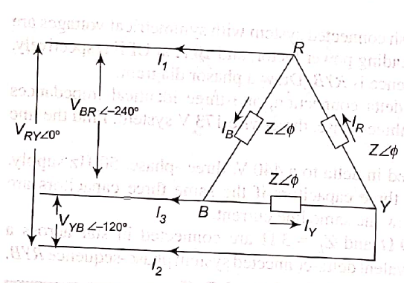
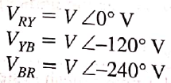
Delta Load

Slide 3
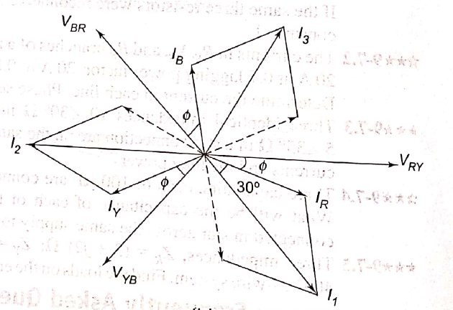

Slide 4

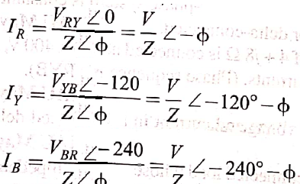

Slide 5
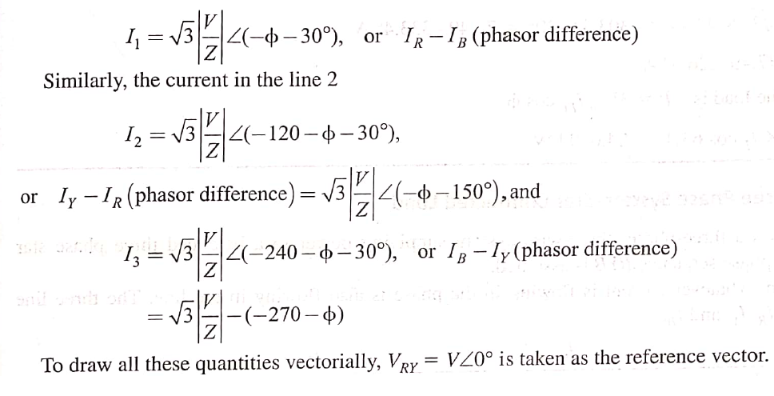

Slide 6
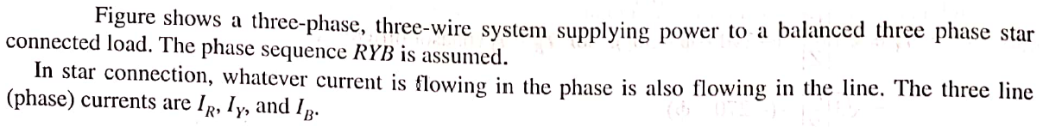
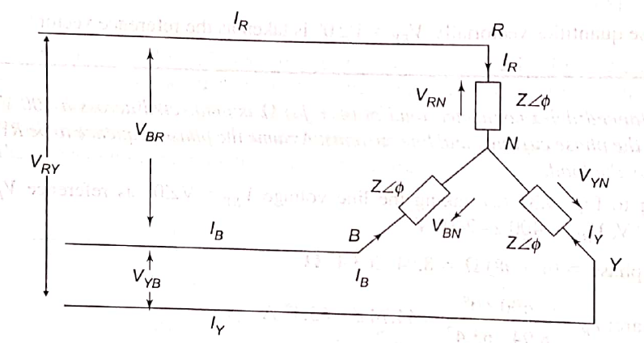
Star Load

Slide 7
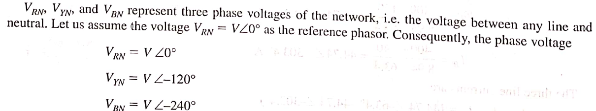
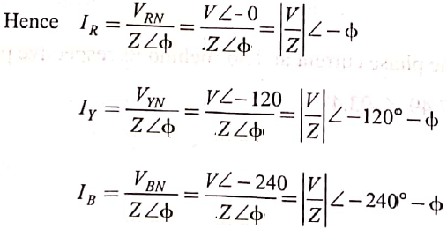

Slide 8
Measurement of power by 2 watt meter method
Two Wattmeter Method can be employed to measure the power in a 3 phase, three wire star or delta connected the balanced or unbalanced load.
In Two wattmeter method the current coils of the wattmeter are connected with any two lines, say R and Y and
the potential coil of each wattmeter is joined on the same line, the third line i.e. B as shown below in figure (A).

Slide 9
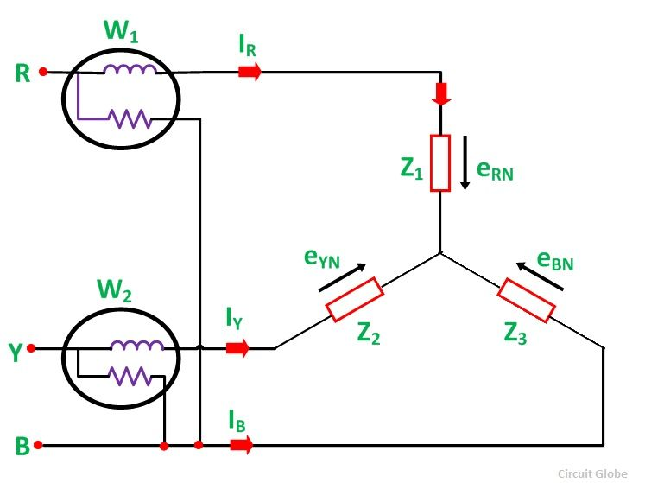
The total instantaneous power absorbed by the three loads Z₁, Z₂ and Z₃, are equal to the sum of the powers measured by the Two wattmeters, W₁ and W₂

Slide 10
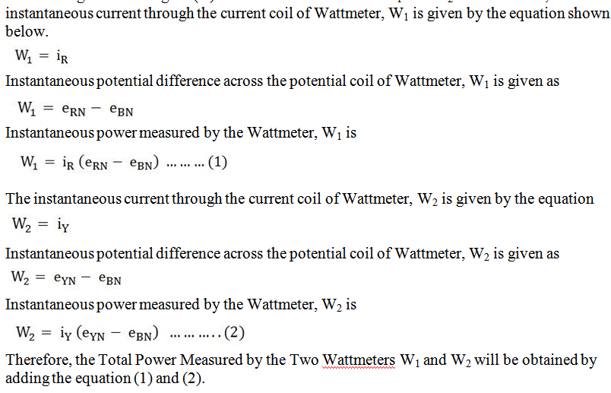
Measurement of Power by Two Wattmeter Method in Star Connection

Slide 11
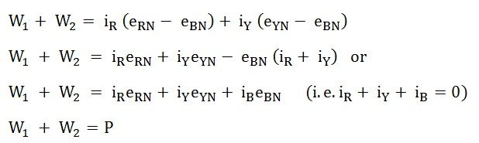

Slide 12
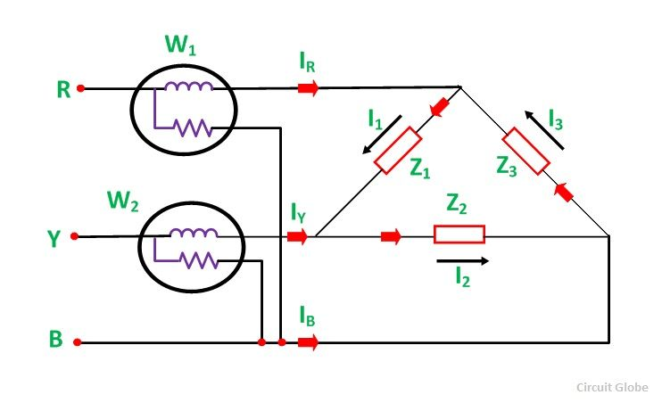
Measurement of Power by Two Wattmeter Method in Delta Connection
Considering the delta connected circuit shown in the figure below.

Slide 13
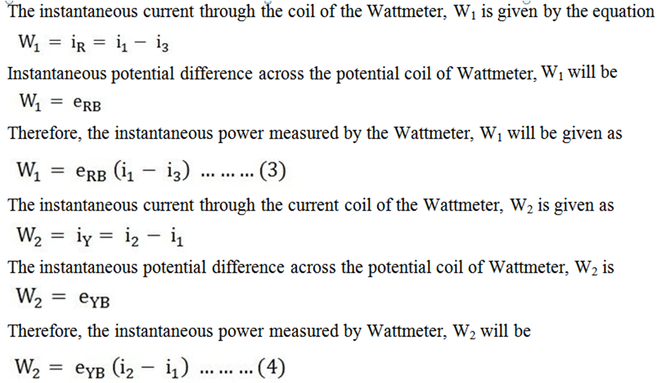

Slide 14
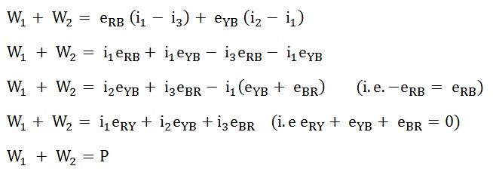
Hence, to obtain the total power measured by the Two Wattmeter the two equations, i.e. equation (3) and (4) has to be added.
Where P is the total power absorbed in the three loads at any instant

Slide 15
Faraday’s law of electromagnetic induction

Slide 16
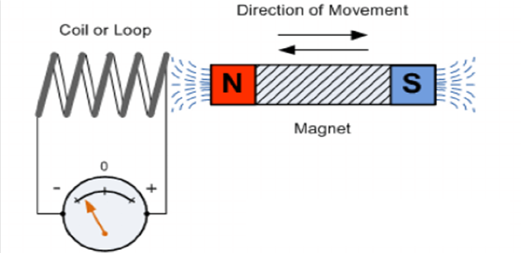
What is Faraday’s Law
Faraday’s law of electromagnetic induction (referred to as Faraday’s law) is a basic law of electromagnetism predicting how a magnetic field will interact with an electric circuit to produce an electromotive force (EMF).
This phenomenon is known as electromagnetic induction.
Faraday’s law states that a current will be induced in a conductor which is exposed to a changing magnetic field.

Slide 17
Lenz’s law of electromagnetic induction
Lenz’s law of electromagnetic induction states that
the direction of this induced current will be such that the magnetic field created by the induced current opposes the initial changing magnetic field which produced it.
The direction of this current flow can be determined using Fleming’s right-hand rule.
Faraday’s law of induction explains the working principle of transformers, motors, generators, and inductors.

Slide 18
Indused emf two types
Dynamically indused emf
Statically indused emf.
Mutually-induced e.m.f.
Self-induced e.m.f.

Slide 19
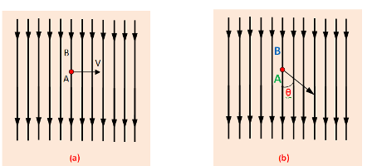
Dynamically induced e.m.f
A is lied within a uniform magnetic field whose flux density is a uniform magnetic field . and the flux density is B wb ³.
In this fig. the movement of the conductor is shown by arrow line. When the conductor A cuts across at right angles to the flux.

Slide 20
Let, ‘l’= Length of the conductor lying within the field.
And it moves a distance dx in time dt,
The area swept by the conductor is =ldx.
Flux cut by the conductor = l.dx X B,
Change in Flux = B.l.dx weber,
Time= dt second
According to Faraday’s laws. The e.m.f induced in the conductor . And this induced e.m.f is known as dynamically induced e.m.f.

Slide 21

If the conductor (A) moves at an angle θ with the direction of flux which is shown in (b).

Slide 22
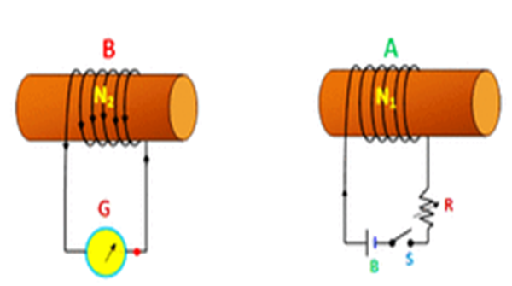
Statically induced E.m.f:-
Statically induced e.m.f is two types which are – i) Mutually-induced e.m.f. ii) Self-induced e.m.f.
Mutually induced e.m.f:-

Slide 23
a current will flow through the coil A and produce a magnetic field in which partly links with the coil B.
As current through A is changed, the flux linked with B is also changed.
According to Faraday’s law, induced e.m.f is produced in the coil B and This e.m.f know as mutually induce e.m.f.

Slide 24
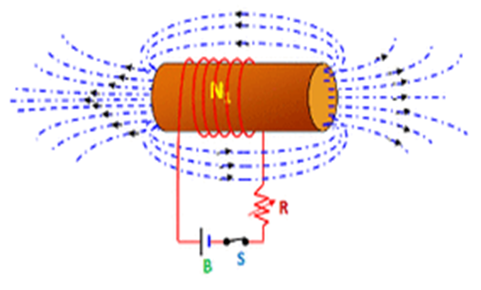
Self-induced e.m.f:
Self-induced e.m.f is the e.m.f which is produced in the coil due to the change of its own flux linked with it.
If the current of the coil is changed, then the flux linked with its own turns will also change which will produce an e.m.f that is called self-induced e.m.f.

Slide 25
DC Generator
A dc generator is an electrical machine which converts mechanical energy into direct current electricity.
This energy conversion is based on the principle of production of dynamically induced emf.
Basic constructional parts of a DC machine are described below.
Yoke:
Poles and pole shoes
Field winding
Armature core
Armature winding
Commutator and brushes

Slide 26
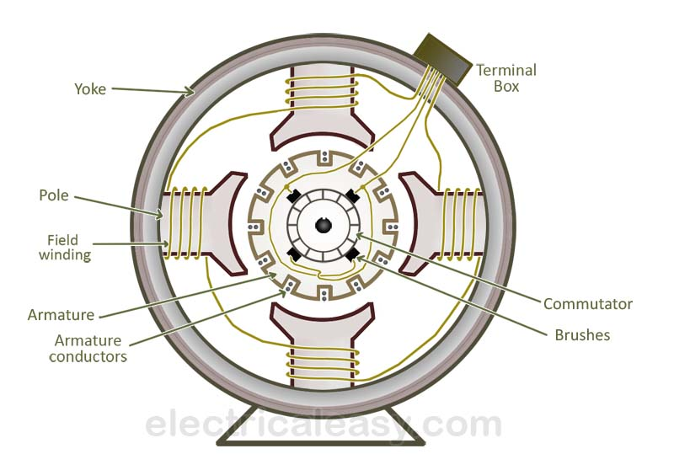

Slide 27
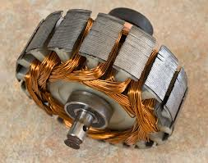
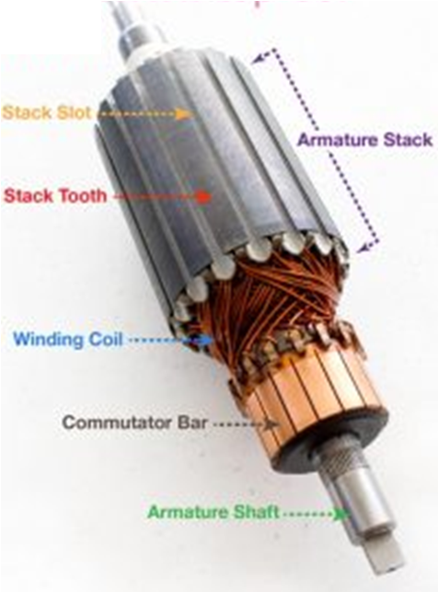
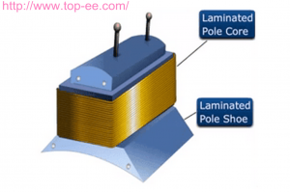
Armature core (rotor)

Slide 28
Working principle of a DC generator:
According to Faraday’s laws of electromagnetic induction, whenever a conductor is placed in a varying magnetic field (OR a conductor is moved in a magnetic field), an emf (electromotive force) gets induced in the conductor.
The magnitude of induced emf can be calculated from the emf equation of dc generator.
If the conductor is provided with a closed path, the induced current will circulate within the path.
In a DC generator, field coils produce an electromagnetic field and the armature conductors are rotated into the field.
Thus, an electromagnetically induced emf is generated in the armature conductors. The direction of induced current is given by Fleming’s right hand rule.

Slide 29
EMF equation of a DC generator
Consider a DC generator with the following parameters,
P = number of field poles Ø = flux produced per pole in Wb (weber) Z = total no. of armature conductors A = no. of parallel paths in armature N = rotational speed of armature in revolutions per min. (rpm)
Now, Average emf generated per conductor is given by dΦ/dt (Volts) ... eq. 1
Flux cut by one conductor in one revolution =dΦ = PΦ….(Weber),
Number of revolutions per second (speed in RPS) =N/60
Therefore, time for one revolution =dt = 60/N(Seconds)
From eq. 1,
emf generated per conductor =dΦ/dt = PΦN/60(Volts) …..(eq. 2)
The conductors are connected in series per parallel path, and the emf across the generator terminals is equal to the generated emf across any parallel path. Therefore, Eg = PΦNZ / 60A

Slide 30
characteristics of DC generators
Generally, following three characteristics of DC generators are taken into considerations:
1. Open Circuit Characteristic (O.C.C.) (E₀/I_{f})
2. Internal or Total Characteristic (E/I_{a})
3. External Characteristic (V/I_{L})

Slide 31
Open Circuit Characteristic (O.C.C.) (E₀/I_{f})
Open circuit characteristic is also known as magnetic characteristic or no-load saturation characteristic.
This characteristic shows the relation between generated emf at no load (E₀) and the field current (I_{f}) at a given fixed speed.
The O.C.C. curve is just the magnetization curve and it is practically similar for all type of generators.
The data for O.C.C. curve is obtained by operating the generator at no load and keeping a constant speed.
Field current is gradually increased and the corresponding terminal voltage is recorded.
The connection arrangement to obtain O.C.C. curve is as shown in the figure below.

Slide 32
